Slide 1
Web Design Fundamentals /
Basic Web Design
Building Website Using Dreamweaver – ITWD103 / ITWD113

Slide 2
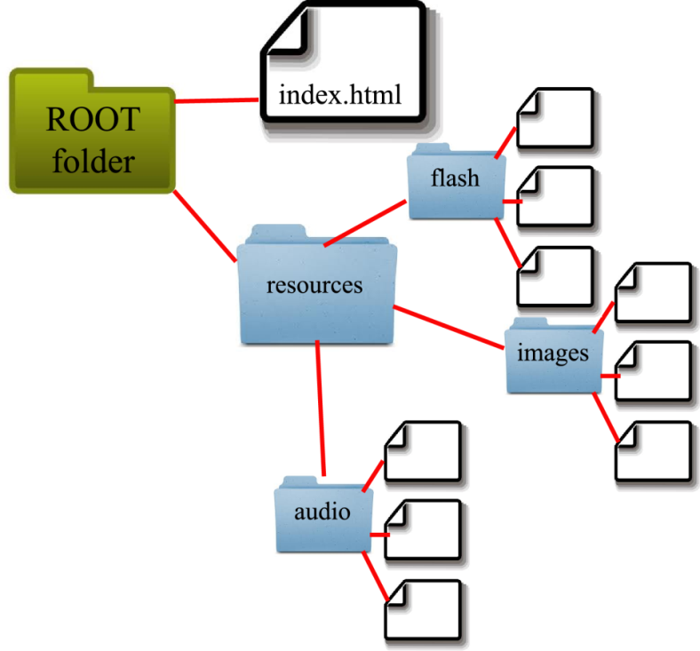
Prelimenaries of Dreamweaver
HTML Markup provides a map to various site resources, including images, videos, audios, flash, java, CSS, and other files.
The Resource Directory is generally holds media files, while HTML files remain in the root folder.

Slide 3
Best practices
.HTM and .HTML are equivalent, but if two files have the same name and are in the same directory, your web server will choose which to use based on its settings.
Both call MIME (Multipurpose Internet Mail Extension) type of text/html on server
HTM is older, back on Windows 3.x extensions could only have 3 characters
The normal default is HTML, but check with your provider.

Slide 4
Best practices
Though many modern servers will allow any file name to be used, it is best to convert your files into the older format that will function with all servers.
All lower case letters (file names are CAPs sensitive)
i.e. Index.html is a different file than index.html
No Spaces, instead use hyphens (-) or underscores (_)i.e.
spaces will be converted to “%20”, resulting in confusing file names
Use Keywords in file names
Keep file names Short
Do not use Special Characters, such as # " & % , etc.

Slide 5
Best practices
File Names: Best practices
Also…
The file name should be no more than 32 characters, including the ".html" or ".htm" file suffix.
There should only be one “.”, placed before the extension
All files should start with a letter
Ensure the proper suffix for the file type (i.e. .html, .jpg, .gif, .css, ect.)

Slide 6
Best practices
These are valid file names: |  | These are invalid file names:
james-smith.html John-and-Marys_Wedding.JPG rWalker.html harrisfiles.html |  | james smith.html John&Mary's.htm 4myWedding.JPG R. Walker.html harris.html_files.html

Slide 7
Best practices
The first word has the most “weight” in how search engines find your page in File Names AND Page Titles. Always use your Keyword first, not a pronoun or introductory word.
The words “A” and “The” are exceptions, as they are generally ignored.
<title>A Smith Family</title> will be indexed under "Smith".
<title>The Smith Family</title> will be indexed under "Smith".
<title>Smith Family</title> will be indexed under "Smith".
<title>My Smith Family</title> will be indexed under "My"

Slide 8
Best practices
When designing a website, organizing the site content BEFORE you start building can save time and resources.
A good way to do this is by building a flow-chart called a Site Map:

Slide 9
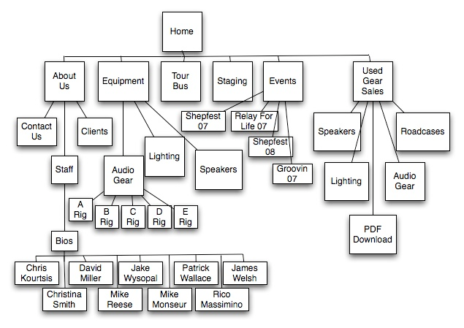
Best practices
Example of sitemap

Slide 10
Best practices
Adobe Dreamweaver is a Graphical User Interface (GUI) for web design.
Adobe offers a package for Web Developers called the Adobe Web Design Premium Package, containing all the software that you need.

Slide 11
<!DOCTYPE>
The <!DOCTYPE> declaration must be the very first thing in your HTML document, before the <html> tag.
The <!DOCTYPE> declaration is not an HTML tag; it is an instruction to the web browser about what version of HTML the page is written in.
Always add the <!DOCTYPE> declaration to your HTML documents, so that the browser knows what type of document to expect.

Slide 12
<meta>
Metadata is data (information) about data.
The <meta> tag provides metadata about the HTML document. Metadata will not be displayed on the page, but will be machine parsable.
Meta elements are typically used to specify page description, keywords, author of the document, last modified, and other metadata.

Slide 13
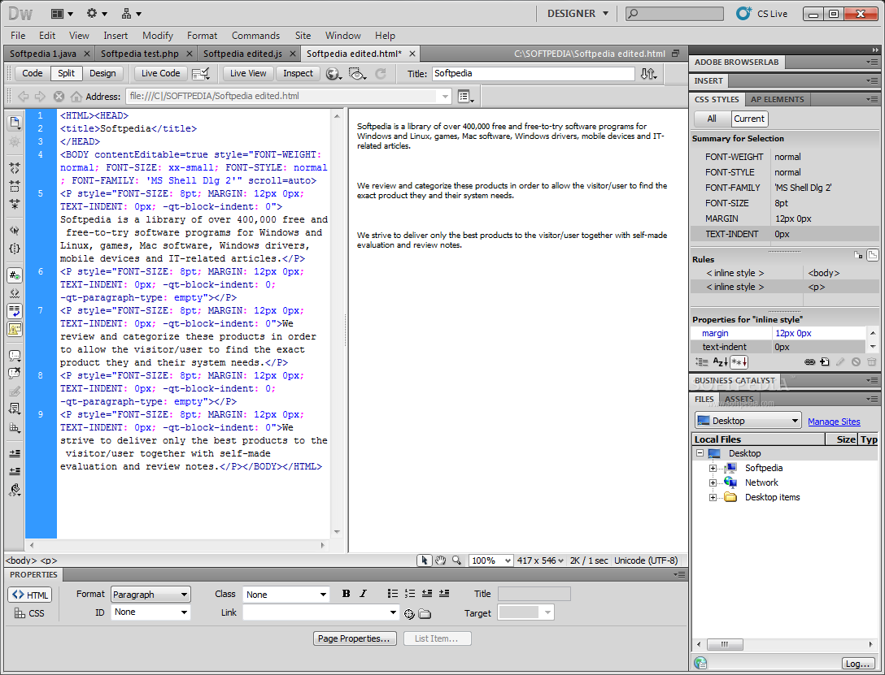
REVIEW: Dreamweaver Environment

Slide 14
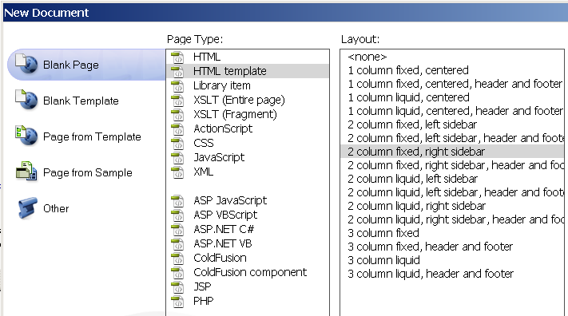
Example Template
Web Templates
Dreamweaver Templates
Note that Dreamweaver comes with many built-in simple templates for you to use.

Slide 15
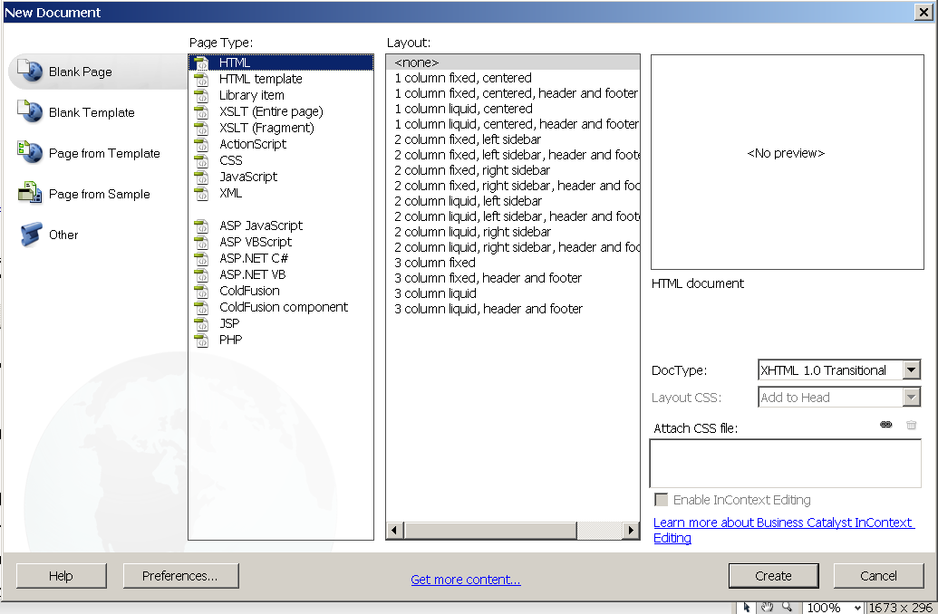
Example Template
For now, let’s just start with a blank document (no template)
Web Templates
Dreamweaver Blank Document

Slide 16
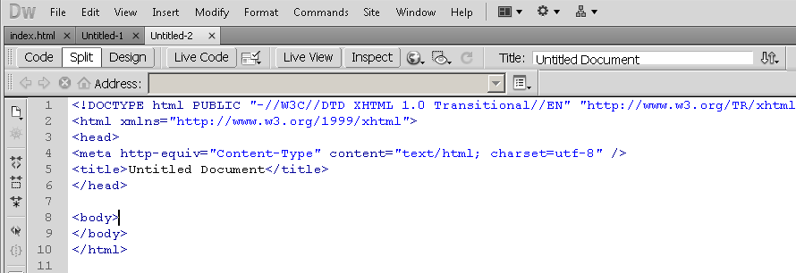
Navigating Dreamweaver
Dreamweaver Basics
Save as first-dreamweaver-page.html
Change the Title (let’s build a New Page for Your Site)
Change title
Or Change title here

Slide 17
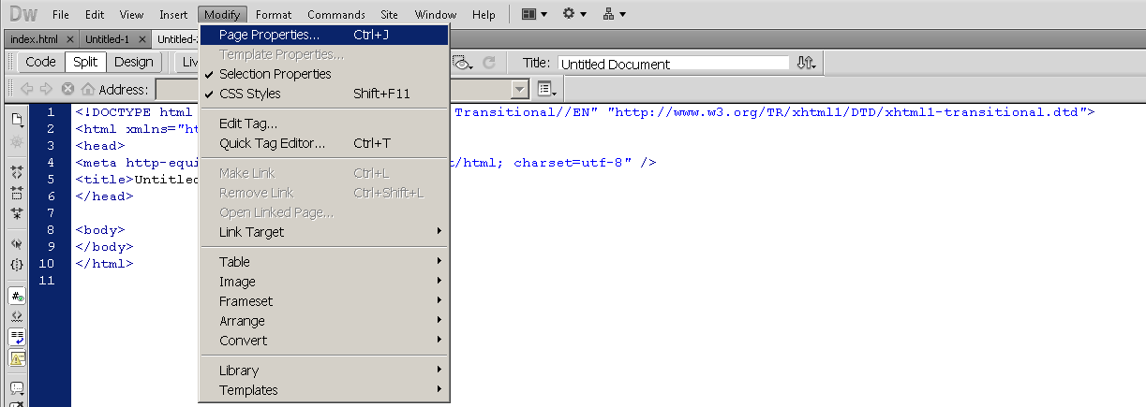
Navigating Dreamweaver
Dreamweaver Basics
Page Properties
Let’s format the page properties

Slide 18
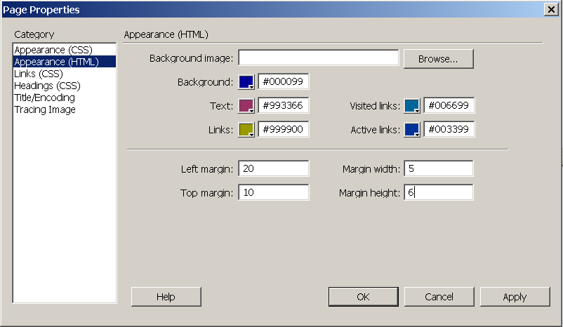
Navigating Dreamweaver
Dreamweaver Basics
Page Properties (choose HTML)

Slide 19
Navigating Dreamweaver
Dreamweaver Basics
Page Properties
Notice what happened in the HTML when you used this tool:
<html>
<head>
</head>
<body bgcolor="#000099" text="#993366" link="#999900" vlink="#006699" alink="#003399" leftmargin="20" topmargin="10" marginwidth="5" marginheight="6">
</body>
</html>

Slide 20
Navigating Dreamweaver
Attributes of the Body tag control the master Page Properties
background="url" | Background Image
bgcolor="#??????" | Background Color
text="#??????" | Document Text Color
link="#??????" | Link Color
vlink="#??????" | Visited Link Color
alink="#??????" | Active Link Color
bgproperties="fixed" | Background Properties - "Fixed" = non-scrolling watermark
leftmargin="?" | Side Margin Size in Pixels (Internet Explorer)
topmargin="?" | Top Margin Size in Pixels (Internet Explorer)

Slide 21
Navigating Dreamweaver
HTML Frames
With frames, you can display more than one HTML document in the same browser window. Each HTML document is called a frame, and each frame is independent of the others.
**This is the “Old way” of designing.
The disadvantages of using frames are:
Frames are not expected to be supported in future versions of HTML
Frames are difficult to use. (Printing the entire page is difficult)
The web developer must keep track of more HTML documents

Slide 22
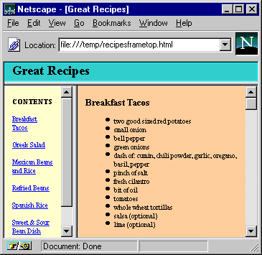
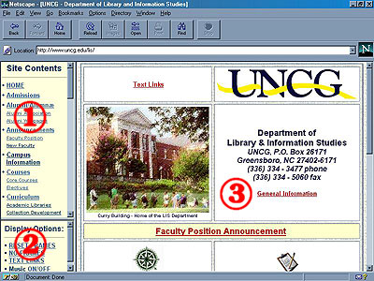
Navigating Dreamweaver

Slide 23
Navigating Dreamweaver
So if HTML Frames are Outdates, why learn them?
Many modern 3rd party sites provide frames you can insert on your own webpage, since not all frames have to be from the same site!
Examples include: Facebook, Weatherbug, Google maps
Some are now offered in XHTML or Javascript format, but many are still coded using “insertable frames”, or “iframe” tags.

Slide 24
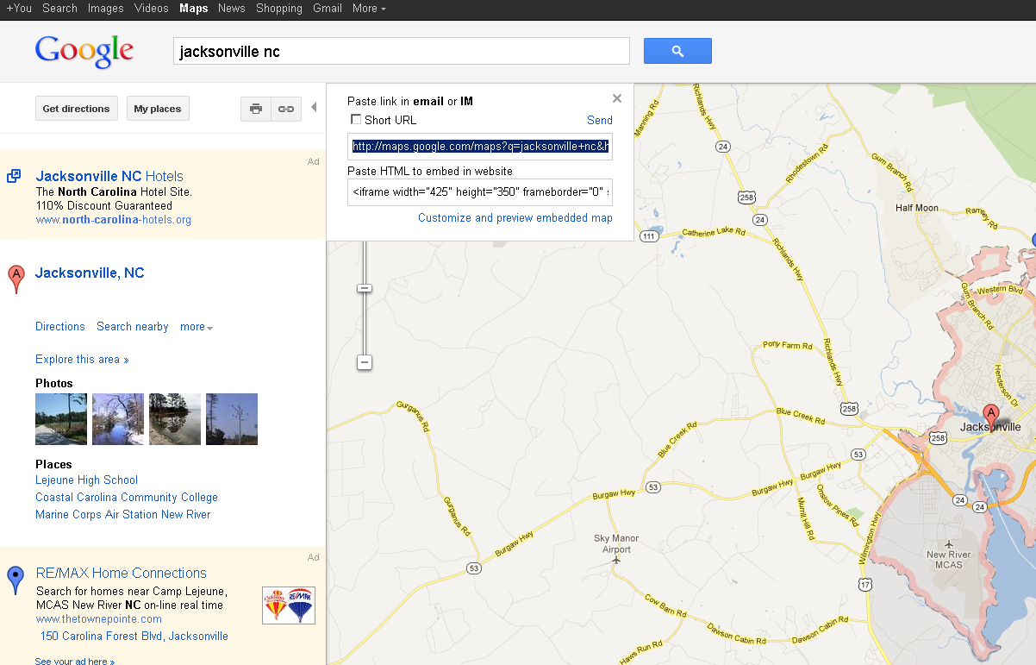
Navigating Dreamweaver

Slide 25
Navigating Dreamweaver
The Google Map Code
<iframe width="425" height="350" frameborder="0" scrolling="no" marginheight="0" marginwidth="0" src="http://maps.google.com/maps?f=q&amp;source=s_q&amp;hl=en&amp;geocode=&amp;q=jacksonville+nc&amp;aq=&amp;sll=37.0625,-95.677068&amp;sspn=55.674612,135.263672&amp;ie=UTF8&amp;hq=&amp;hnear=Jacksonville,+Onslow,+North+Carolina&amp;t=m&amp;z=12&amp;ll=34.754052,-77.430241&amp;output=embed"></iframe>
<br />
<small><a href="http://maps.google.com/maps?f=q&amp;source=embed&amp;hl=en&amp;geocode=&amp;q=jacksonville+nc&amp;aq=&amp;sll=37.0625,-95.677068&amp;sspn=55.674612,135.263672&amp;ie=UTF8&amp;hq=&amp;hnear=Jacksonville,+Onslow,+North+Carolina&amp;t=m&amp;z=12&amp;ll=34.754052,-77.430241" style="color:#0000FF;text-align:left">View Larger Map</a></small>

Slide 26

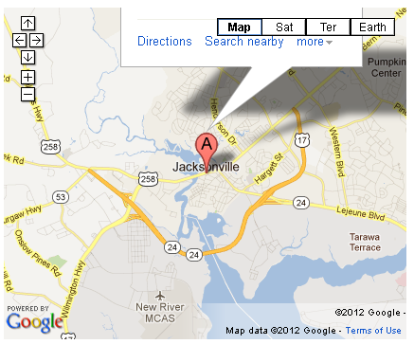
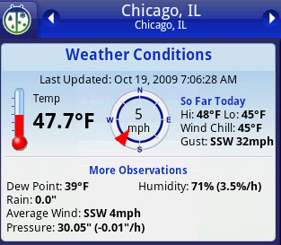
Navigating Dreamweaver
Some iFrame Widget Examples
FaceBook “Like” Widget
Google Map Widget
Weatherbug Live Weather Update Widget

Slide 27
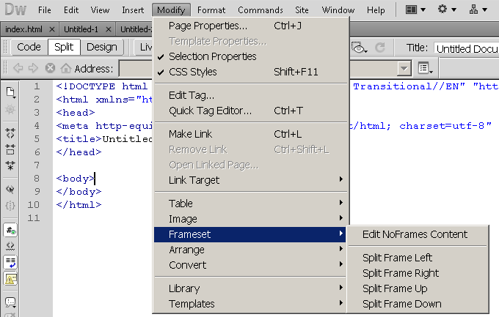
Navigating Dreamweaver
Creating Frames in Dreamweaver

Slide 28
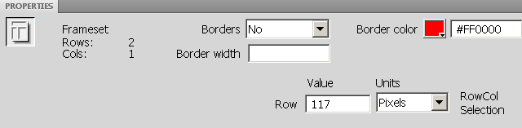
Navigating Dreamweaver

